Slide 1

Amazon Sales Data Analysis
Project report
By Deepak V

Slide 2
Objective
Sales management has gained importance to meet increasing competition and the need for improved methods of distribution to reduce cost and to increase profits. Sales management today is the most important function in a commercial and business enterprise.
Problem Statement
To perform ETL of the dataset and find the trend for Sales on yearly, monthly and yearly month wise.
Analyze the key factors, metrics and generate meaningful recommendations and insights.

Slide 3


Tools Used
To clean the messy data and to structure it according to the objective.
To Extract and transform the data accordingly.
To visualize the data for key factors and metrics.

Slide 4
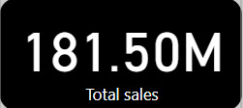
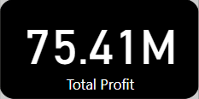
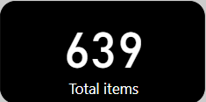
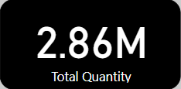
Insights

Slide 5
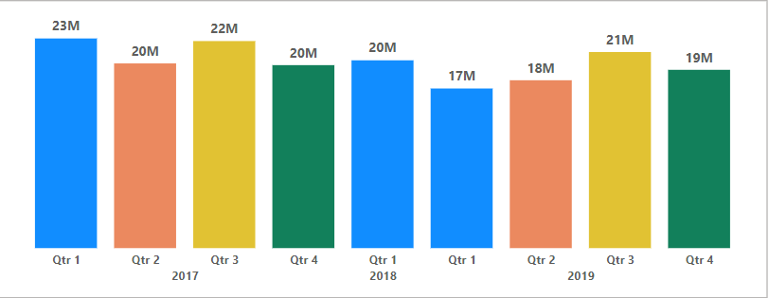
Total Sales by year and Quarter
The Total sales of all three years can be seen below.
Q1 - 2017 and Q3 – 2019 has the highest sales. Year 2018 has only one quarter.

Slide 6
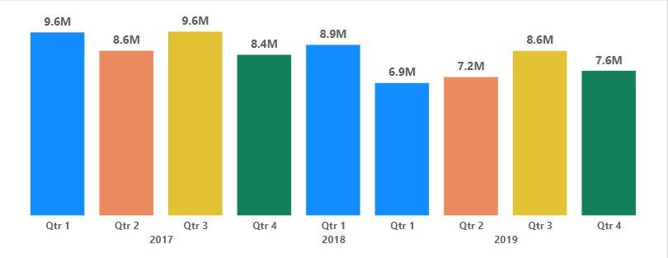
Total Profit by Year and Quarter
Q1, Q3 in 2017 and 2019 has gained the highest profit with 9.6million.
Q1 – 2019 has gained the lowest profit with 6.9million.

Slide 7
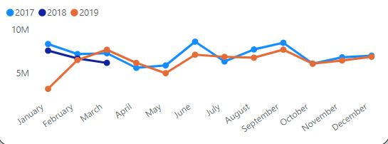
Monthly Sales by Year and month
As we have seen earlier, we have only one quarter in 2018 where in January month has the highest sales.
In the year 2017 June has the highest and April has the lowest sales.
In the year 2019 September has the highest and January has the lowest sales.

Slide 8
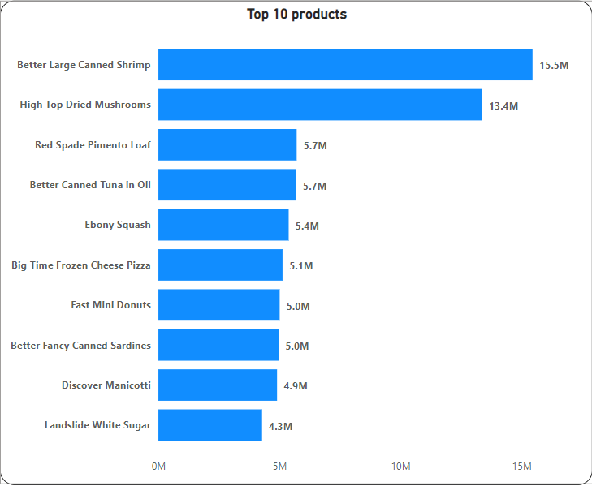
Top 10 Products by Revenue
Better Large Canned Shrimp, High top dried mushrooms and Red spade pimento loaf are the top three products with highest sales.

Slide 9
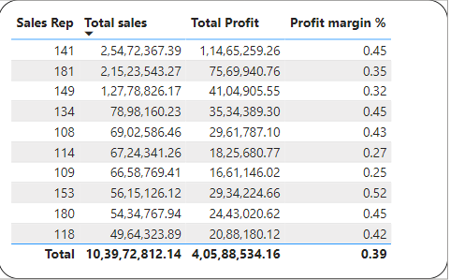
Top 10 Sales representatives
Sales Representatives 141, 181 and 149 are the top three sales representatives based on total sales. We can also observe their total profit and profit margin too.

Slide 10
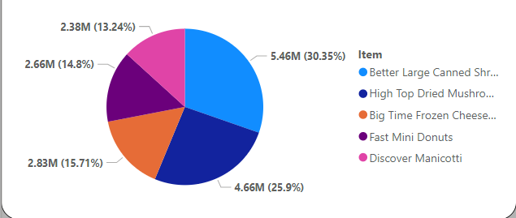
Top 5 profitable items
Better large canned shrimp and high top dried mushroom has topped the list in both high sales and high profits.
Unlike top sales items listed previously third, fourth and fifth profitable items are different which can be seen below.

Slide 11
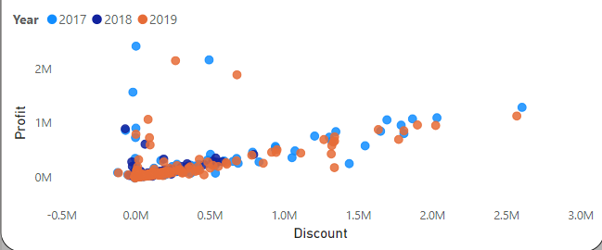
Relationship between discount price and Marginal amount(Profit).
As we can observe from the below scatter plot, as the discount price increases profit decreases.

Slide 12
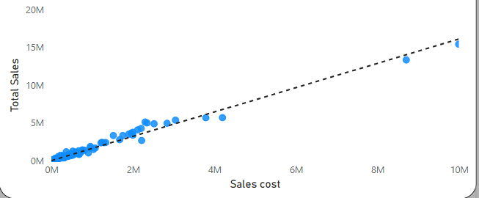
Relationship between sales cost and sales amount.
As we can observe below when the sales cost increases, sales amount or the selling price also increases. So, here we can assume that the profit margins will be more.

Slide 13
Conclusion
Year 2017 has topped the list with high sales and profits, 2019 is second highest in sales and profits and 2018 being the last.(Note : Only first quarter’s data is available for the year 2018).
Month-wise March, June, September has recorded higher sales and April, May, October has recorded lower sales. During these months company can provide discounts and cashbacks on items.
Month-wise March, June, September has recorded higher profits and April, May, October has recorded lower profits.
Top three items w.r.t sales are Better Large Canned shrimps, High topped dried mushroom and Red spade pimento Loaf.
We can observe from the scatter plot as the discount rises sales margin decreases and vice versa.
As the sales cost increases total sales also increases and vice versa.

